Slide 1
What makes Sherard a great place to be?

Slide 2
Everyone is kind and caring
We all work hard
Teachers make learning fun
Our classroom is a calm place to be
We feel safe in school and in the playground
We are respectful and show good manners
We include everyone
We feel valued and cared for

Slide 3
It is our good behaviour and positive attitudes that make this happen.
However………..
Sometimes we don’t always take responsibility for our choices.
Sometimes we forget our manners.
Sometimes we interrupt the learning of others.
Sometimes we are unkind.
Sometimes there are children who hurt others with words or by using their fists or feet.
Sometimes we are not 100% honest.

Slide 4
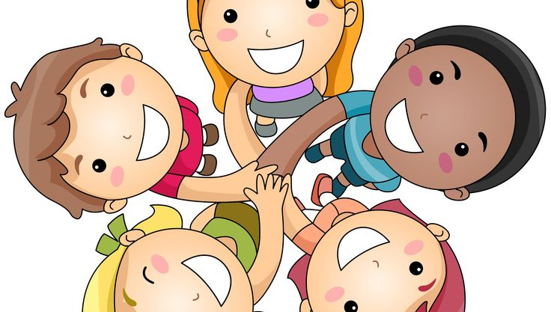
We are going to make this even better and be the very best we can be!
Everyone is part of the Sherard dream team!!
How are we going to get even better?

Slide 5
From today we are having a whole new system of rewards and also clear consequences if anyone forgets and makes a poor choice.
Don’t forget……….
You are in charge of your behaviour
We will expect everyone to take responsibility for their actions
Manners are very important
The older you are, the more we expect you to set an excellent example
Being rewarded for doing the right thing makes you feel great
It is never ok to be disrespectful to any adult or child in our school

Slide 6
Look at all of these rewards…..

Slide 7


Class smileys can be earned for demonstrating good manners and sensible behaviour around school. You can get them at lunchtime and for keeping your classroom and cloakrooms tidy. You will set yourselves a target each week. If you reach your target, your class will earn 5 minutes towards golden time. The class with the most smileys each week will be class of the week and will earn 15 minutes to use or bank.
You will continue to get Dojo points in class and work towards your class total each term.

Slide 8
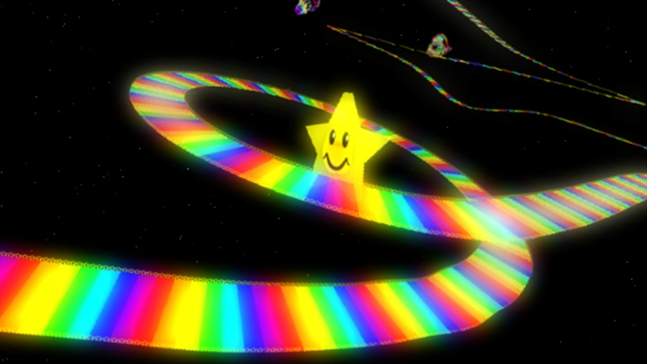
Rainbow Road!
Your aim is to get onto Gold 3 times in one week. If you achieve this, you will earn Gold Star Status.
So how do you do this??

Slide 9
Everyone will start on GREEN every day. This is our minimum expectation. What you should be doing all the time.
If you exceed these expectations, your teacher or another adult in school might ask you to move to SILVER.
If you demonstrate effort or behaviour which is exemplary, you might be asked to move to GOLD!
Get here 3 times in a week and you will be a super Gold Star Student for a week!! (Names will be collected by 11:15 on a Friday so if you get to Gold after this on a Friday, it will count for the following week.)

Slide 10
Lunchtimes
We expect behaviour and manners to be just as good at lunchtimes. You will be treated with respect and must give respect in return.
Rewards
Golden Table raffle
Class smileys
Stickers and praise
Consequences
A verbal warning
Time on the reflection bench
Time out with Mrs Bacon, Mrs Blumfield or another teacher
A letter home
A lunchtime exclusion

Slide 11
Consequences of poor behaviour choices.
If your teacher feels you are not behaving appropriately, they will give you a verbal warning. If you ignore this, you will move to yellow and will have a time-out in your classroom. You will reflect on why you are there and will have to make up the time at break or lunch.
If you continue to ignore your teacher and repeat your behaviour, you will move to orange. You will then be taken to another classroom to continue your work and reflect on how you can put things right. Your parents or carers will get a letter to let them know that you made a poor choice.
In the very rare situation where you continue to cause disruption and make poor choices. Mrs Bacon or Mrs Blumfield will be sent for. This is extremely serious and will mean that you will be excluded from working in your class for a period of time. Your parents or carers will also be informed.

Slide 12
Some behaviour is so serious that it might mean going straight to red or being sent straight in at lunchtime.
Physically hurting someone on purpose
Swearing at an adult or child
Being extremely rude to an adult or child
Damaging our school equipment
These are a few examples but it will be up to the adult dealing with the situation to make that choice.

Slide 13
Every day is a fresh start
You will begin every day on green.
You can always get back to green if you have moved down. This will be up to you.
Everybody makes mistakes. As long as we learn from them, then we can move forwards.

