Slide 1
Welcome Back!

Slide 2
On 20th March schools closed because of Covid-19 (coronavirus).

Slide 3



This meant people:
  Had to stay at home.
  Could only go for exercise once a day.
  Could only go to the shops for essential items.
  Sometimes the Covid-19 pandemic rules had to change to keep people safe.

Slide 4




We could not hug or play with our friends.
We could not go and see family members who did not live with us.
We could not go to the cinema or play in the park.
We could not attend clubs, go for days out or go on holiday.

Slide 5


People kept using the new words:
Social Distancing
This meant that we had to stay 2 metres away from people who did not live with us.

Slide 6











Some people liked being at home
Some people found it difficult and boring
Most of us will have enjoyed parts of lockdown and not enjoyed other parts.

Slide 7




Everybody’s situation and experience was different.
People’s feelings and thoughts were also different.

Slide 8

There is no right way to feel or respond in stressful situations.
  Early on you may have been in shock and felt confused, helpless or anxious.
  You may have also felt scared or sad.

Slide 9

As time went on you may have felt angry with yourself or with others. You may have even felt guilt or shame.

Slide 10

You may have been visualising or dreaming about the virus, or of your loved ones getting ill.

Slide 11
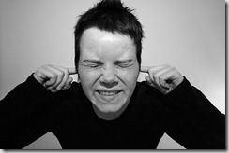
You could have found yourself avoiding anything about Covid-19, including talking to other family members or blocking out thoughts.

Slide 12
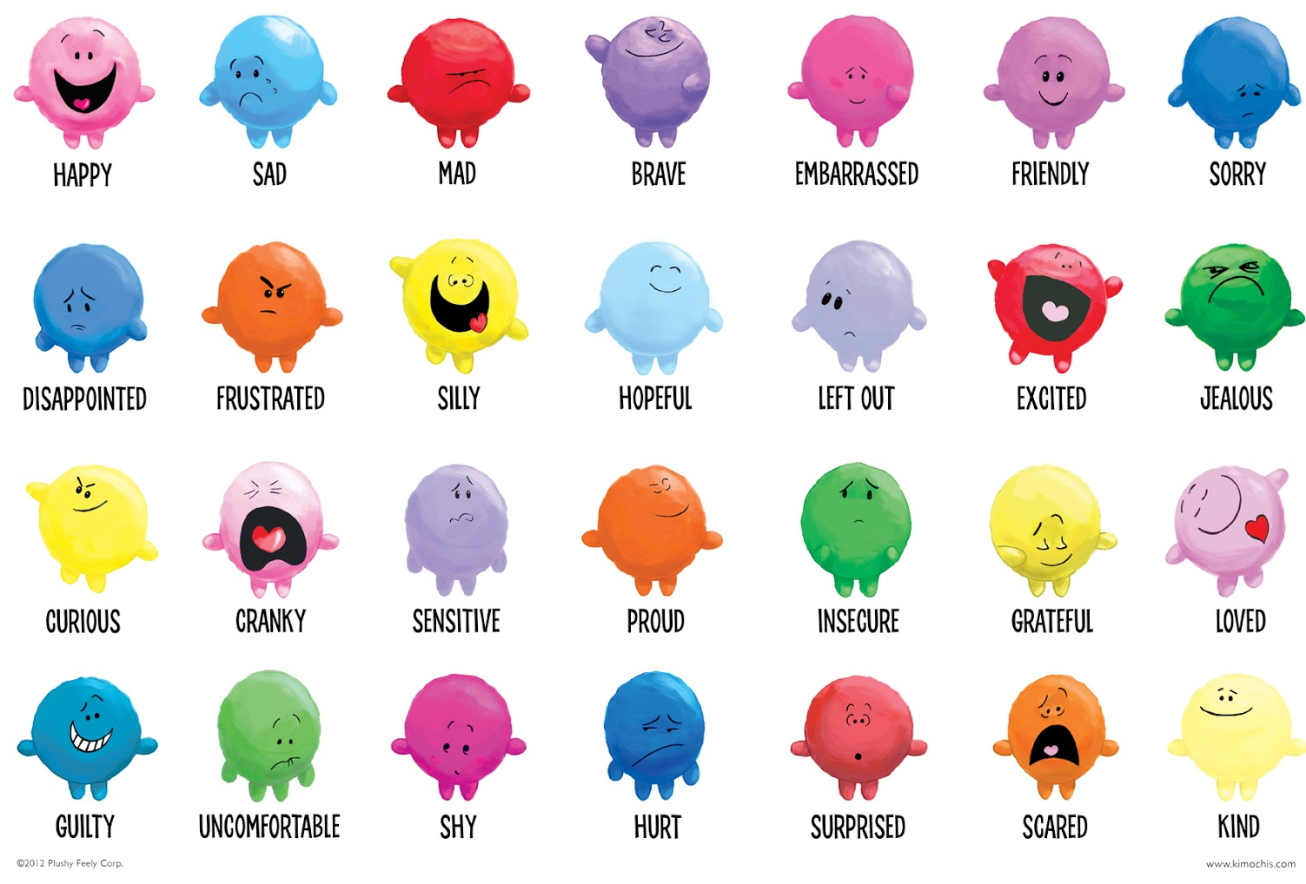
How are you feeling?
Notes:
Look at original document and add descriptions

Slide 13
Hopeful - That your life will return to normal. People can start to feel more positive about things quite soon after a trauma.
Embarrassed - That you have these strong feelings you can’t control, especially if you need others to support you.
Frightened - That the same thing will happen again, or that you might lose control of your feelings.
Relieved - That the danger is over.
Helpless - That something really bad happened and you could do nothing about it. You feel vulnerable and overwhelmed.
Guilty - You have survived when others have suffered or died. You feel you could have done something to prevent it.
Sad - If people were injured or died, especially someone you knew.
Angry - About what happened and with whoever was responsible.

Slide 14

Adults had new challenges that they had never experienced before and had similar thoughts and feelings, which is OK.
You may have thoughts and feelings that you have not experienced before, which is OK.

Slide 15

Teachers had to send your work home.
Parents had to try and teach you at home.
Lots of your parents had to work from home.
Some of your parents are important keyworkers and had to still to go to work as ‘normal’.
As families we have spent more time together than any other time before – which sometimes was good and other times not so good!

Slide 16
What else have I noticed in my body?

Slide 17
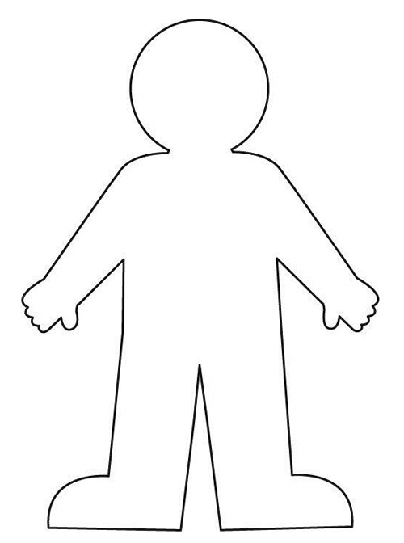

Suffer from headaches.
Poor concentration
Cannot sleep, or when asleep you dream a lot and have nightmares.
Memory problems and difficulty thinking clearly.
Feel very tired.
Feel that your heart is beating faster.
Changes in appetite.
Aches and pains
Notes:
Add ‘what else I might notice’ list. E.g. headaches

Slide 18
I was worried my classroom had changed and I wouldn’t know it.
I’m worried I will find the work too hard.
I have had to get back into the school routine.
Coming back to school may have been a challenge because…..
I have forgotten what some people look like.
I found it hard to get up in the morning.
What other challenges could you have experienced?
I was excited but nervous to see my friends.

Slide 19

There are some new rules that we ALL (adults and children) need to understand.
That’s ok because I have people around me who want to help me.
So what are our new rules?

Slide 20
  Teachers
  Teaching Assistants
  Friends
  Parents and other family members
  Lunch time supervisors
  School Office Staff
Just like before when you were at school, if you don’t understand anything you can ask:

Slide 21
What can I do?

Slide 22
Give yourself time
It takes time to accept what has happened and to learn to live with the new changes.
It is better to face the reality of what happened rather than wondering about what might have happened.
Support Network
If you go to funerals or memorial services it can help to spend time with others who have been through the same experience as you.
Find out what happened
Ask for Support
It can be a relief to talk about what happened.
You may need to ask your friends and family for the time to do this – at first they will probably not know what to say or do.

Slide 23
Take time for yourself
At times you may want to be alone or just with those close to you.
Even if you don’t feel like eating try and have regular meals and eat a balanced diet.
Physical Exercise
Talk it Over
Gradually let yourself think about what happened and talk about it with others. Don’t worry if you cry when you talk, it’s natural and usually helpful.
Take things at a pace you feel comfortable with.
Get into a Routine
Taking some exercise can help, but start gently.
Some people find moving about and playing sports can provide some temporary relief and occupy your mind with other thoughts.
Relaxing Activities
It can be good to spend time relaxing and doing activities such as hobbies, drawing, writing or listening to music.

Slide 24
What is the same at school?

Slide 25
What is different at school?

Slide 26
Your GP/Doctor
Childline – 0800 1111
Winston’s Wish – 08452 030405
For further help and support you can contact:

